Slide 1

AVR AGM Agenda 2023
Chairman’s Welcome
Agree Minutes of the Previous AGM
Treasurer's Report
Secretaries’ Reports
Challenges and Successes
Goal Getters
Constitutional Amendments
Membership Fees
Next Year
Committee officers standing down
Election of Committee Officers 2023

Slide 2
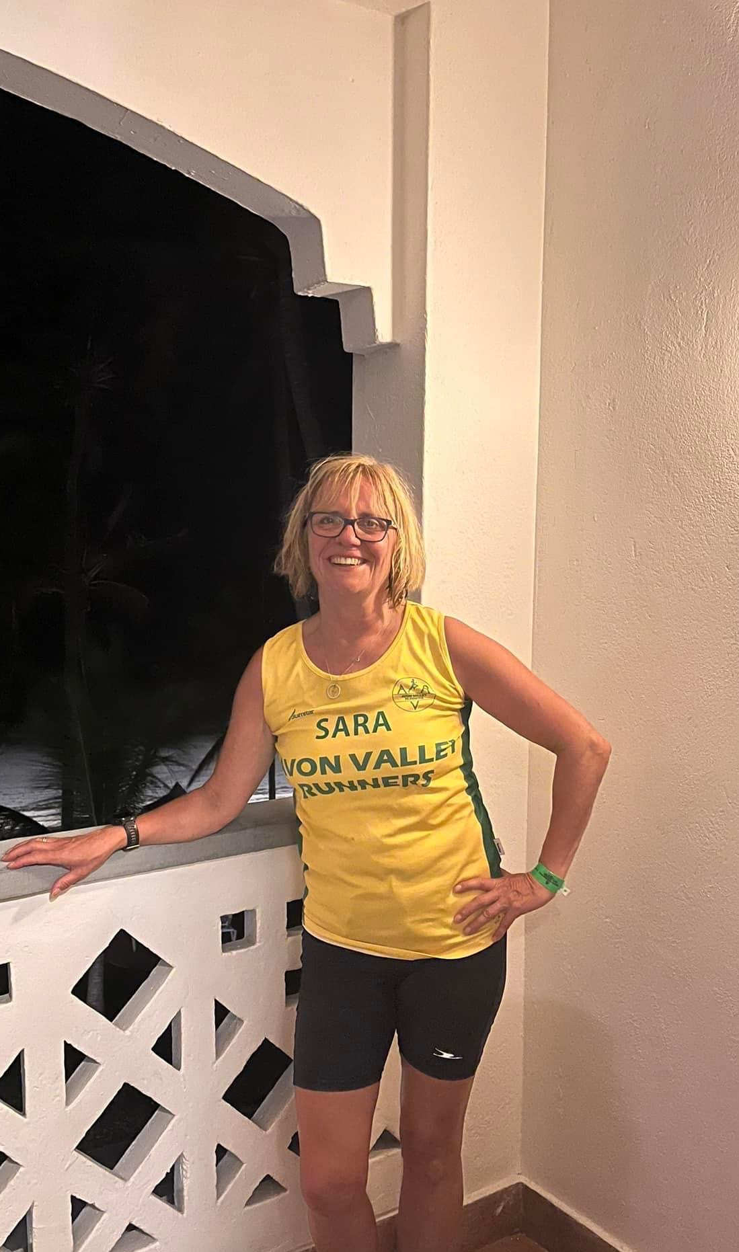
Chairman’s Welcome
Sara Robert

Slide 3
Good evening and thank you for coming this evening
I’d like to open the meeting by thanking the current committee for all their hard work through the last year. We have been through some challenging times and the committee support has been amazing
In particular I would like to thank David Hyde for stepping in to cover Chair at short notice in May and also Vicky Bodman, Jay Sims-Bagshaw and Warren Wade for assisting over the few months in the summer when the club was in some turmoil.
I took the post of Chair at the end of September and am slowly but surely finding my feet with the great support of David Hyde who us now club secretary
I look forward to another year of AVR achievements across the youth and adult sections alike!

Slide 4
Agree Minutes of Previous AGM

Slide 5
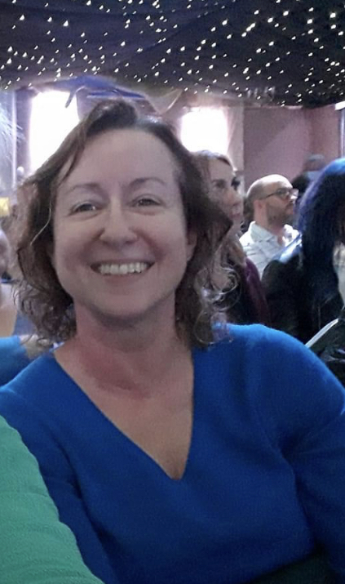
Treasurer’s Report
Sheona Yellowlees

Slide 6
Overall Summary in year surplus of £900
New Funnel
Storage
OTH and Half performance
Implementation of electronic payment for kit
Membership down
Rent increase

Slide 9
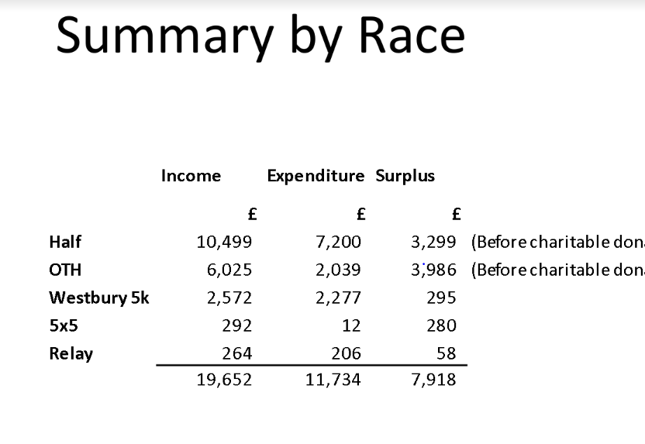

Slide 10
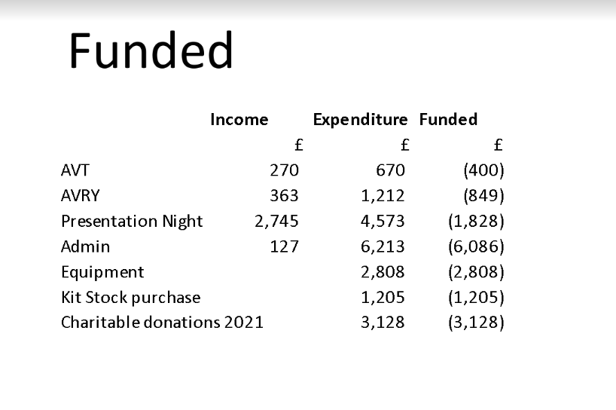

Slide 11
Any member wishing to inspect the accounts in full may do so by emailing the Treasurer:
treasurer@avonvalleyrunners.org.uk
Many thanks,
Sheona Yellowlass
Honourary Treasurer 2022

Slide 12
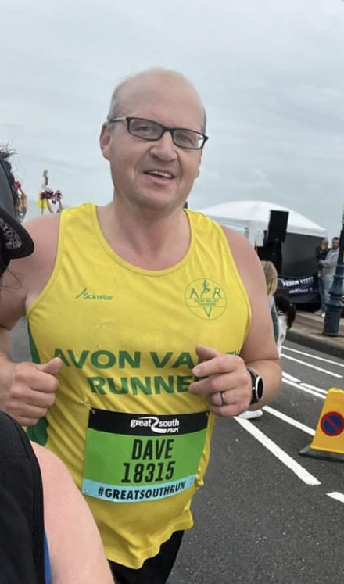
Secretaries Report
Dave Hyde

Slide 13
This Year Has been full of Club Records set by some of our amazing runners noting
Gary Macalister
Robin- Marks Schols
Diane Hier
Jackie Rockliffe
We have completed in the Road Race League and Off Road League with notable success.
The club events have been absolutely second to none and acknowledged far and Wide
AVR Relay
5 x 5
Westbury 5k
Over The Hills
Wiltshire Half Marathon
Stan Farr

Slide 14
None of this would be possible without the fantastic Race Directors who have stepped up and run the events but also you our members who have volunteered far and wide with tremendous feedback.
AVRY has continued to grow from strength to strength as have the run groups and track sessions put on by our run leaders and coaches.
Goal Getters scheme has been again a massive success and our Multi Sport AVT section is making strides and is becoming extremely popular.
Thank you to everyone for their support in 2022 and here's to 2023!

Slide 15
Membership Report
At the end of 2022 we have 373 members, which includes 25 life members (so 348 paying members).
Of the 373, 168 have applied for EA membership.
63 of the 373 are brand new members
V80 - 7
V70 - 12
V60 - 54
V50 - 98
V40 - 100
Sen - 81
Youth/Junior - 21

Slide 16
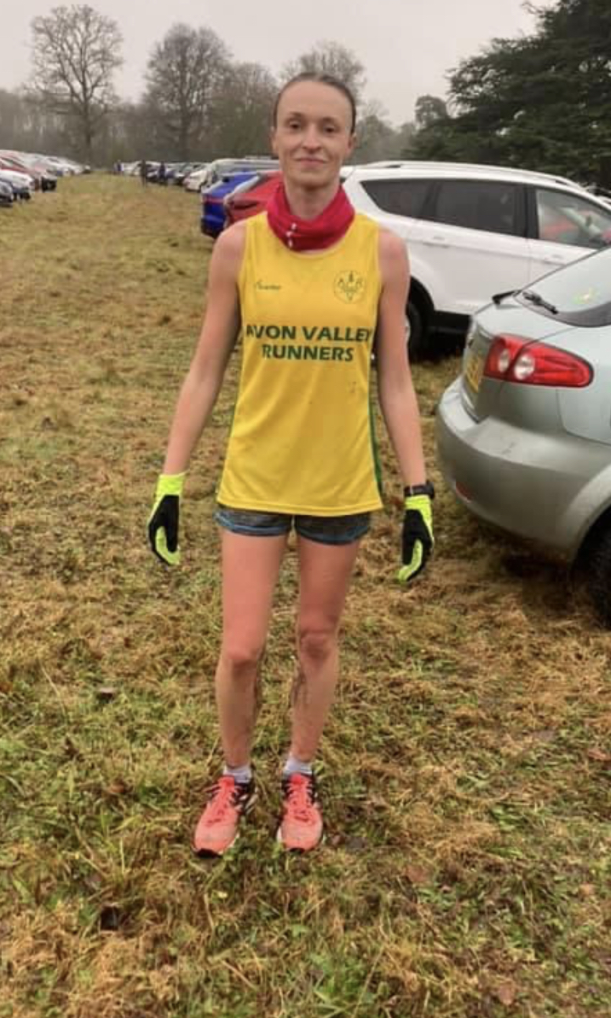
Road Report
Gemma Knudsen

Slide 17
Road Report
This year AVR once again took part in the Wiltshire road race league and we also used the same races for our club road league. There were 8 fixtures in the league with the best 6 scores to count. This years league included Calne Clock Change 10k, Highworth 5 miles, Hullavington Half, Lacock 10k, Heddington 5k, Compton Bassett 5 miles, Malmesbury 10k and Devizes 10k.
AVR finished in second place in the Wiltshire league, losing out by 1 point to Royal Wootten Bassett Hounds. AVR members Tim Burrell and Andrew Sharratt also won the Wiltshire male vet 50 and vet 60 prizes. There were only 6 AVR members who took part in a full set of 6 races, but 91 members who raced in at least of the league fixtures. The most popular races of the league were Highworth 5 with 28 AVR members running and Devizes 10k with 26 runners.

Slide 18
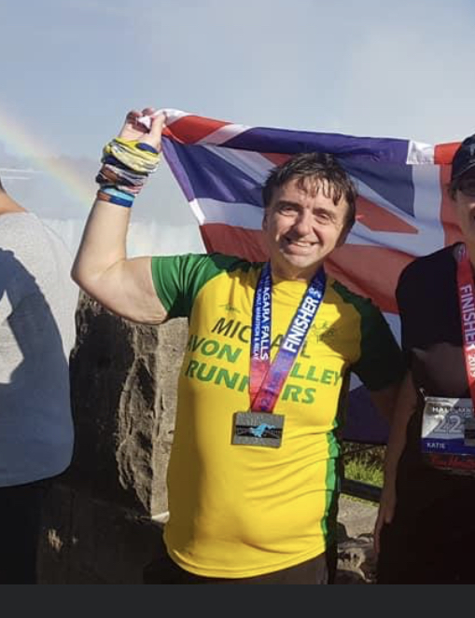
Off Road Report
Michael Guy

Slide 19
Off Road Report
Thanks to Anthony Hickson, who was Off-Road Secretary for the first part of the year after which Michael Guy took over.
AVR Off-Road A finished the 21/22 season in 5th place and the B-team unfortunately got relegated to division two.
After 4 races of the off-road league the AVR A are in 4th place and the B-Team are in 4th place in Division Two.
In the AVR Off-Road League, Gary Macalister is the runaway winner for the men being the only one to complete 8 races in the series. The ladies was a close run but went to Pauline Bradley overall.
Andrew Sharratt is taking over as Off-Road Secretary from January 2023 as Michael has stepped down due to personal time constraints.

Slide 20
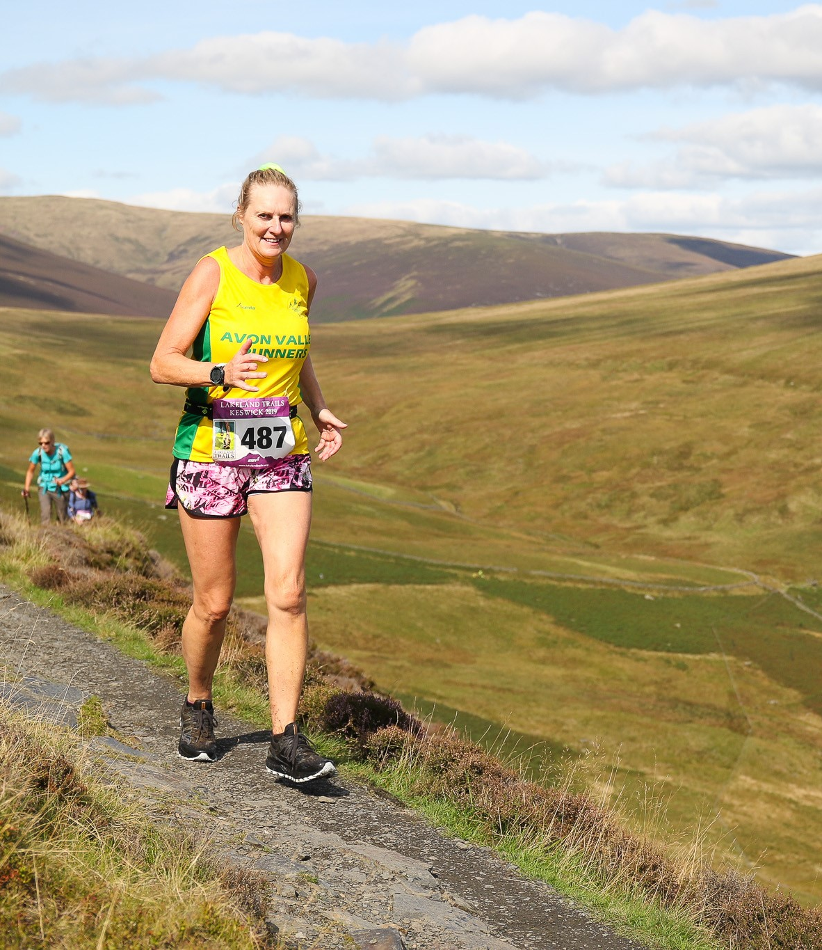
AVRY Report
Debbie Ellis

Slide 21
AVRY Report
AVRY have had an active year, however the training sessions are term time only.
The beginning of 2022, we were half way through the Gwent Cross Country league of which quite a few of our youth participated and did very well. They were also participating in the schools cross country competitions with some qualifying for Wiltshire.
We are currently half way through Gloucester Cross Country League which some youth attending.
The training sessions moved onto track running for spring and summer and there was a couple of AVR events at the Bath University track which some of the youth attended and had a great evening,
Some of our Youth had reached the ages of 16/17 during 2022 and have moved on to the Wednesday evening adult interval session or moved on to other clubs or other sports.
However we have quite a few younger, newer members joining and getting enquiries all the time.

Slide 22
The coaching is going very well with Richard Ayling Chris Redshaw and Richard Smith with support of LIRFs.
The focus for AVRY 2023 is to progress their training and concentrate on more racing this year.

Slide 23
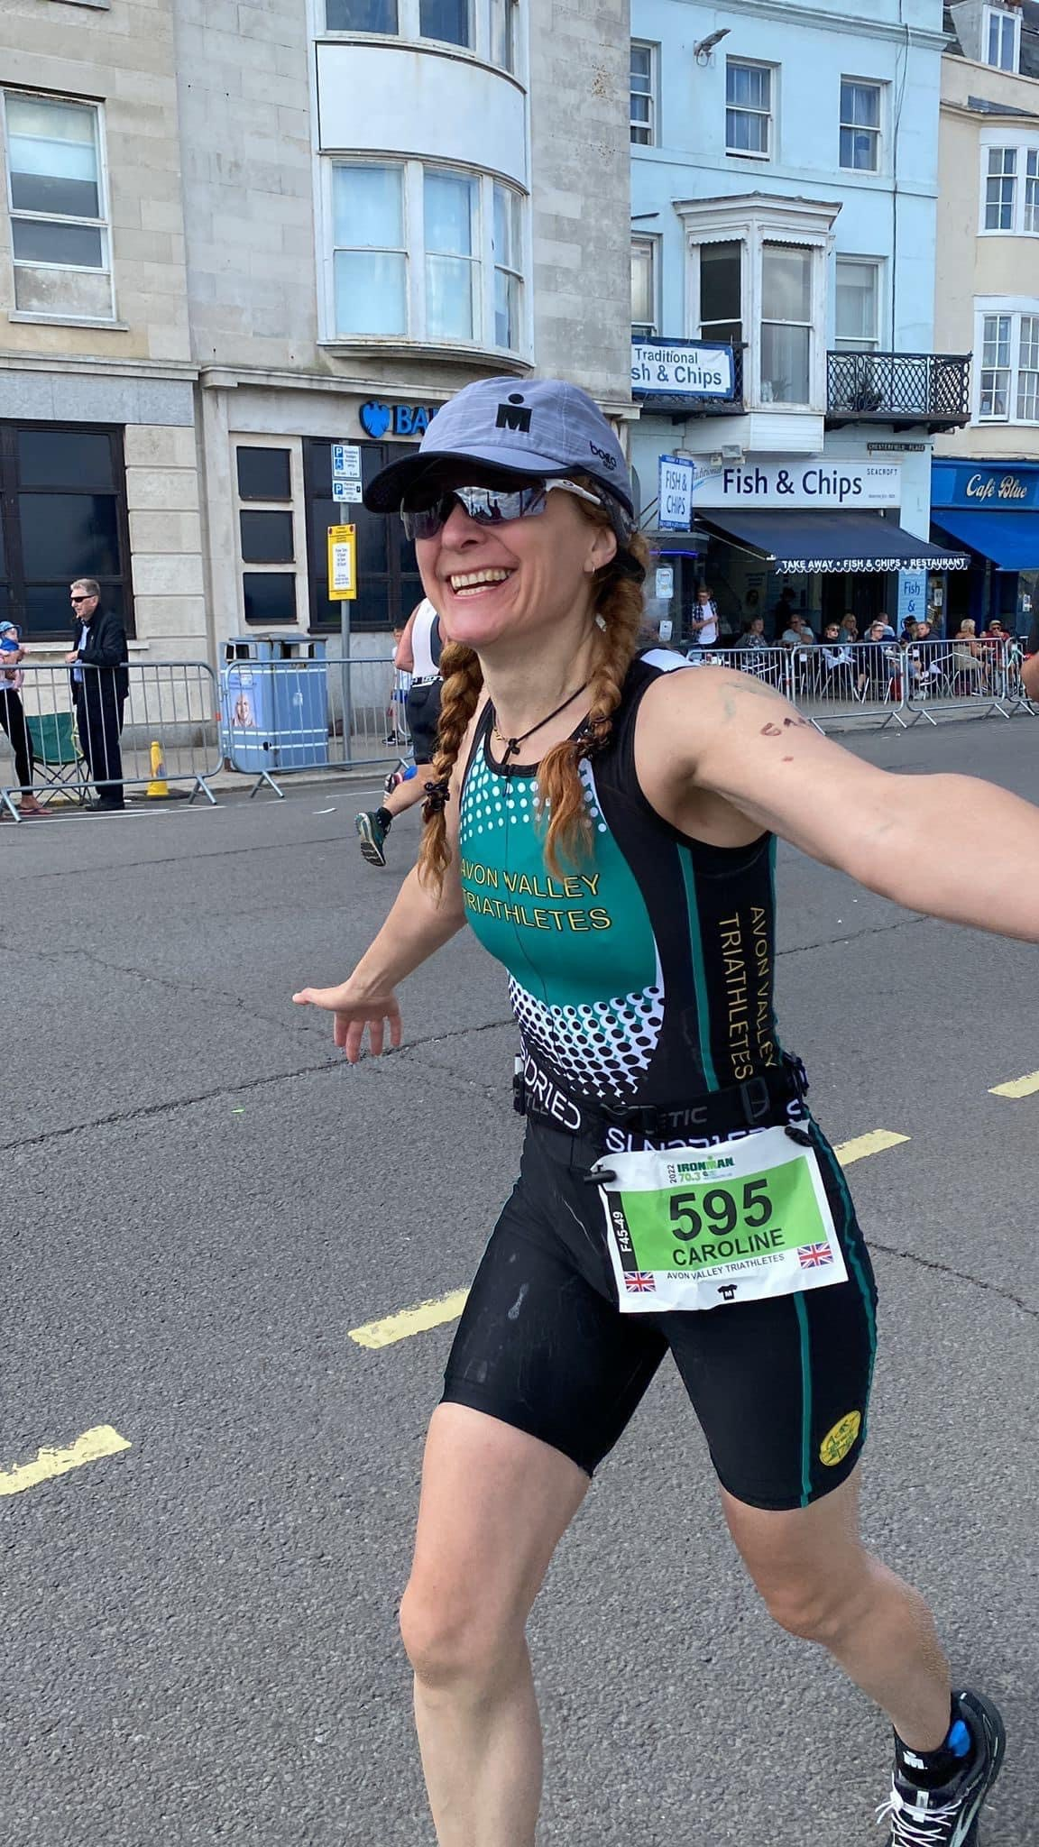
AVT Report
Caroline Scott

Slide 24
AVT Report
AVT has been active all year with a calendar of events that members were able to attend. We did 51Fiver as a team event where we had each discipline undertaken by a different person for the swim, bike, run. This was so well received we are back in 2023!
A large group of AVT were aiming for Ironman 70.3 in Weymouth in September which took a lot of training time to be able to compete, taking over lives! This was successfully completed with a few quite new to the distance and well supported on the day by those not competing.
We started coached swimming as a pilot with all sessions sold out which has led to this being a provision that we can now offer into 2023.
We have had a Strava segment competition which got quite competitive towards the end as more members got involved and wanted to be on the leaderboard.
We hosted an AVT 10 mile time trial around castle combe (which included one of the segments from the competition) which was fiercely competitive with close times for both men and women categories.

Slide 25
The run to breakfast has attracted a wider group of runners to our informal Saturday morning runs which included visits to local cafes.
Towards the end of the year the focus has been on offering multisport provision to a wider group and we are building on the swimming and cycling provision for 2023.
4 people representing GB age-group at triathlon, duathlon and aquabike this year.
We have seen further enhanced engagement from members on channels such at the AVT Pathways messenger group (a new channel created to support beginners) and AVT FB page. We also created a handbook for all newcomers and a calendar of AVT focus events. Additionally, new AVT run vest has been created.
The new AVT Goal Getter programme received 6 gold achievers and one silver. Next year we will be raising the presence of this further by integrating it with the maybe AVR GG goals.

Slide 26

AVR Goal Getters
This year we had 34 members who achieved a GG medal this year which is excellent.
We have to give a special mention to Vicky Bodman and Annalie Ibison who achieved triple Gold in all 3 section
Me vs Me
AVR GG Challenge
AVT GG Challenge
Thank you very much to the organisers and mentees
Sean Price – Presentation
Notes:
SP

Slide 27
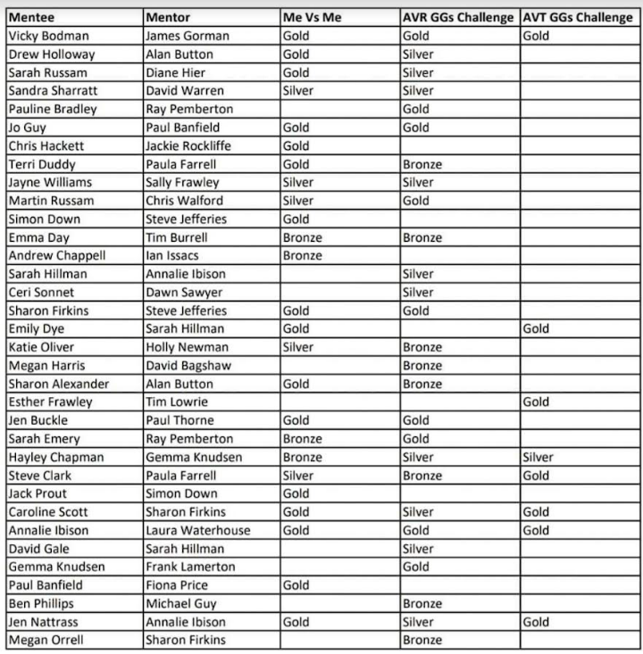

Slide 28
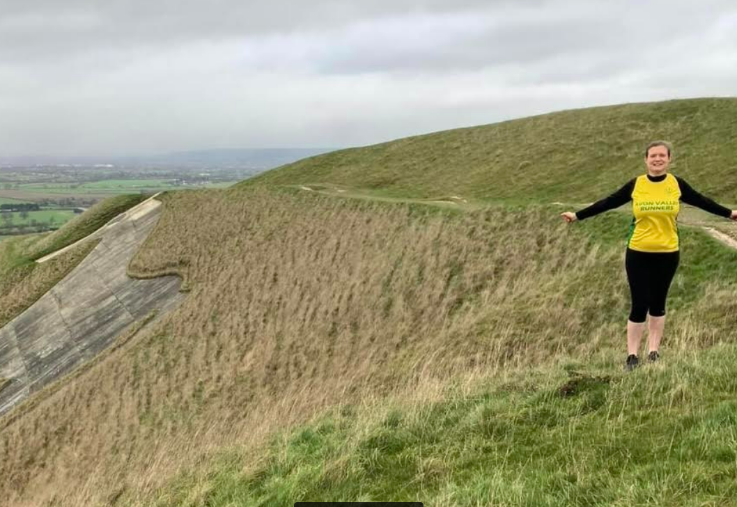
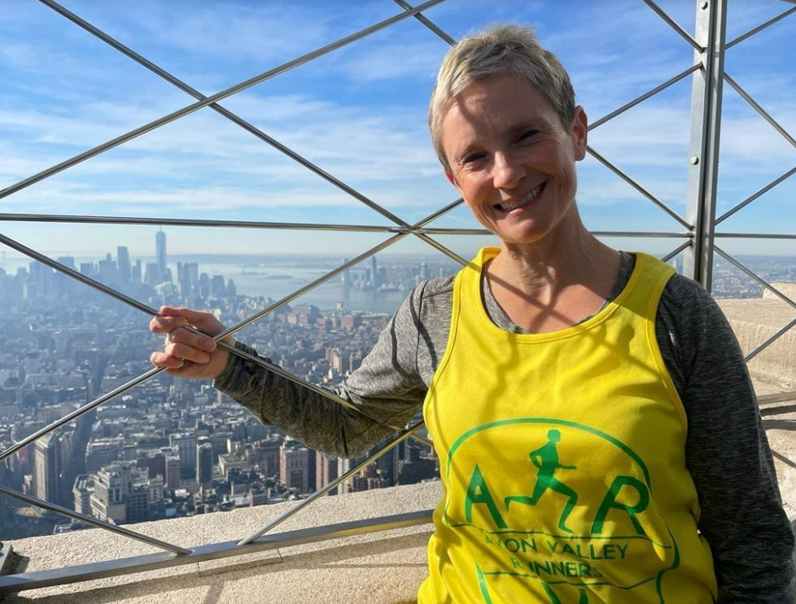
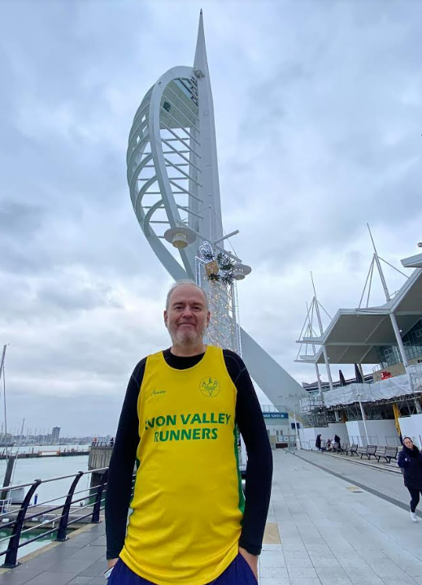
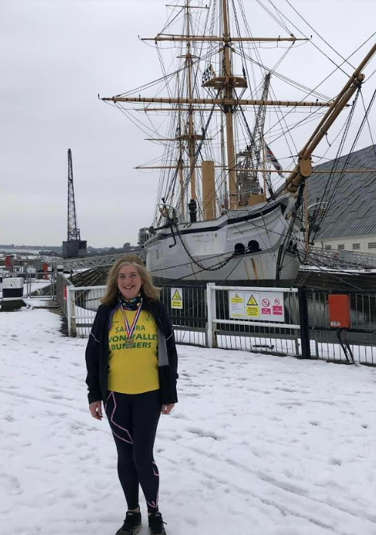
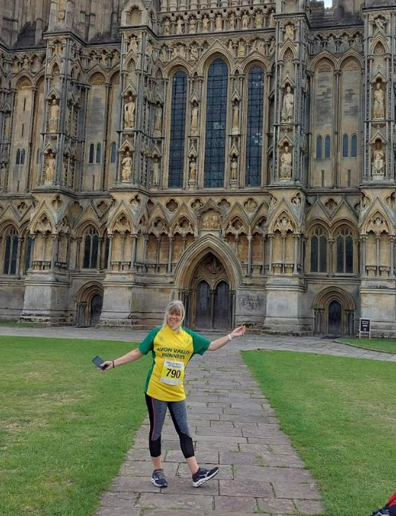
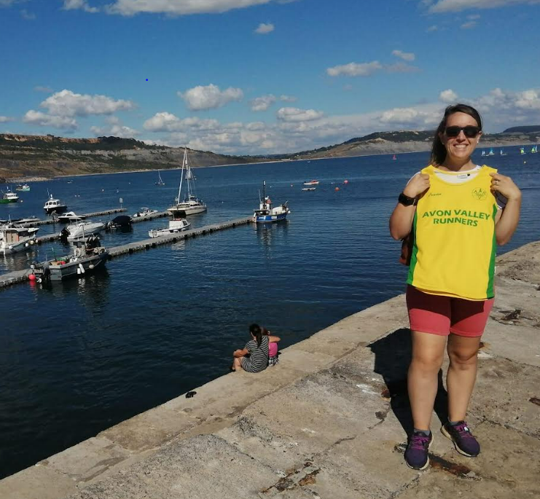

Slide 29
Constitutional
Amendments
1. The change of name of the youth section of Junior Avon Valley Runners to Avon Valley Runners Youth (AVRY). The young athletes need to feel they are part of the club and encouraged to filter into the adult section as one body
2. Avon Valley Runners Youth (AVRY) is not separately financially accountable section of the club that is responsible for members aged 11 to 16 inclusive.
Notes:
WW

Slide 30
Membership Fees
The committee proposes that we increase the annual membership fees for 2022/23:-
Junior/Student - £13.50
Adult - £27
TRFC Fees have increased 12% this year and we need to remain Solvent.
EA membership will remain optional for those people who require or wish to sign up for it but this has gone up by £1 this year.
Notes:
WW

Slide 31
Next Year
Conclusion
Next year will see the club focus on several areas including:
    CIRF’s and LIRF’s – Continuation and Growth of club sessions
    Presentation Evening
    Current Working groups:
      Social
      AVRY
      AVT
      AVR Half – Vicky Bodman and Hayley Anderson
      Over the Hills – Ed Knudsen
      AVR Westbury 5K Gary Macalister
      Goal Getters
      AVR Relay
Notes:
VB

Slide 32
Outgoing Committee
Members
Sheona Yellowlass - Treasurer
Gemma Knudsen – Road Race Secretary
Michael Guy – Offroad Secretary
Carole Alston – Safeguard Lead
The whole club would like to thank Sheona, Gemma, Michael and Carole for their contribution. Their continued support of the club is very much appreciated.
Notes:
VB

Slide 33
Election of Committee
Name | Role
Sara Robert | Chairman
Dave Hyde | Honorary Secretary
Dave Hyde | Vice Chair
Simon Reeves (Temporary) | Honorary Treasurer
Debbie Ellis | AVRY Secretary
Martin Russam (New) | Road Race Secretaries
Andrew Sharratt (New) | Off Road Race Secretary
Emma Day | Membership Secretary (Admin)
Caroline Scott | Multi Sport Secretary
Jay Sims Bagshaw (New) | Safeguarding Lead
Hayley Anderson | Minutes Secretary
Notes:
VB with president

Slide 34
Welfare Officers
Name | Role
Jay Sims - Bagshaw | Welfare Officer AVR Female
Alan Button | Welfare Officer AVR Male
Sara Robert | Safeguarding Officer AVRY
Notes:
VB with president

Slide 35

Ticket Sales Close 23rd January
Notes:
WW

