Slide 1

AVR AGM Agenda 2024
Chairman’s Welcome
Agree Minutes of the Previous AGM
Treasurer's Report
Secretaries’ Reports
Goal Getters
Development Survey
Membership Fees
Lifetime Membership
Next Year
Election of Committee Officers 2024

Slide 2
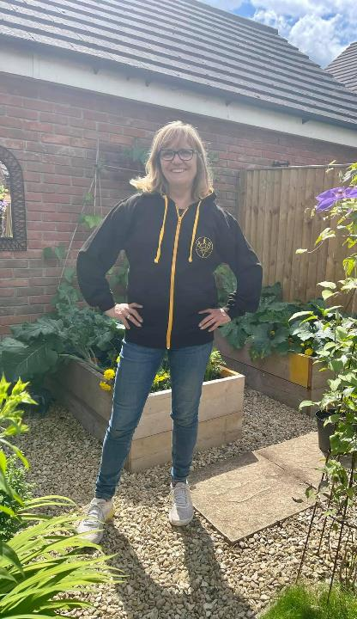
Chair’s Welcome
Sara Robert

Slide 3
Good evening and thank you for coming this evening
I’d like to open the meeting by thanking the current committee for all their hard work through the last year.
A big thank you to everyone in the club who helps our events take place and represents the club at races.
There are so many volunteers behind the scenes as well as front facing. Thank you all so very much.
I look forward to another year of AVR achievements across the youth and adult sections alike!

Slide 4
Agree Minutes of Previous AGM

Slide 5
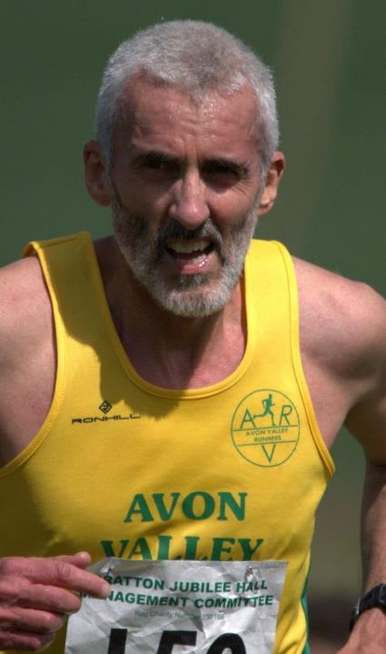
Treasurer’s Report
Simon Reeves

Slide 6
 |  | Income |  | Expenditure
Membership |  | £ 8,326.50 |  | -£ 468.18
EA Subs |  | £ 2,737.00 |  | -£ 2,749.36
Presentation Night |  | £ 2,197.00 |  | -£ 5,210.55
Other Social |  | £ - |  | -£ 742.37
Club Kit |  | £ 879.00 |  | -£ 518.40
AVR Half |  | £ 11,389.10 |  | -£ 9,138.84
AVR OTH |  | £ 6,320.00 |  | -£ 4,748.00
AVR 5k |  | £ 3,472.00 |  | -£ 2,745.80
Other AVR Races |  | £ 27.00 |  | -£ 306.75
Other Races |  | £ - |  | -£ 980.80
AVT |  | £ 1,323.96 |  | -£ 1,538.80
Special Projects |  | £ 428.00 |  | -£ 580.00
Coaching |  | £ - |  | -£ 837.76
Volunteers |  | £ - |  | £ -
Other |  | £ 474.38 |  | -£ 7,242.27
Fees |  |  |  | -£ 4,657.95
Tfr to Deposit A/C |  |  |  | £ -
Total |  | £ 37,573.94 |  | -£ 42,465.83
Annual Balance |  |  |  | -£ 4,891.89

Slide 7
F
Financial Status
Financial Status | 2023
Bank - Current account | £12,680.02
Bank - Deposit account | £ 5,115.89
Cash in hand | £ -
Total Cash Assets | £17,795.91
Stock of Club kit | £ 3,139.00
Cash held by EntryCentral | £ 50.00
Cash held by AVT | £ 984.68
Fixed Assets | £ 3,078.10
Total Assets | £25,047.69

Slide 8
AVR Races 2023
Races |  | Income | Expenditure | Balance
AVR Half |  | £ 10,911.00 | -£ 7,207.96 | £ 3,703.04
AVR OTH |  | £ 6,320.00 | -£ 3,214.00 | £ 3,106.00
AVR 5k May |  | £ 1,471.00 | -£ 906.20 | £ 564.80
AVR 5k June |  | £ 790.00 | -£ 804.80 | -£ 14.80
AVR 5k July |  | £ 630.00 | -£ 762.50 | -£ 132.50
AVR 5k H'cap |  | £ 581.00 | -£ 267.30 | £ 313.70
AVR 5k Total |  | £ 3,472.00 | -£ 2,740.80 | £ 731.20
Totals |  | £ 20,703.00 | -£13,162.76 | £ 7,540.24

Slide 9
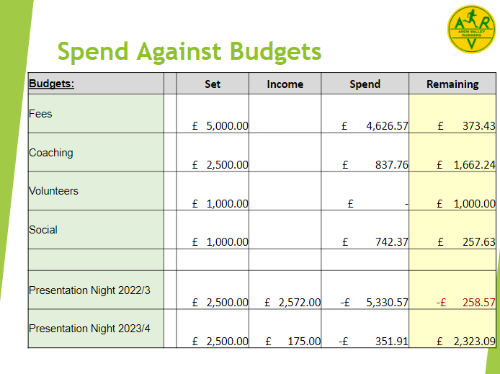
Spend Against Budgets
Budgets:
Set
Income
Spend
Remaining
Fees
£ 5,000.00
£ 4,626.57
£ 373.43
Coaching
£ 2,500.00
£ 837.76
£ 1,662.24
Volunteers
£ 1,000.00
£ -
£ 1,000.00
Social
£ 1,000.00
£ 742.37
£ 257.63
Presentation Night 2022/3
£ 2,500.00
£ 2,572.00
-£ 5,330.57
-£ 258.57
Presentation Night 2023/4
£ 2,500.00
£ 175.00
-£ 351.91
£ 2,323.09

Slide 10
Any member wishing to inspect the accounts in full may do so by emailing the Treasurer:
treasurer@avonvalleyrunners.org.uk
Many thanks
Simon Reeves
Honorary Treasurer 2023

Slide 11
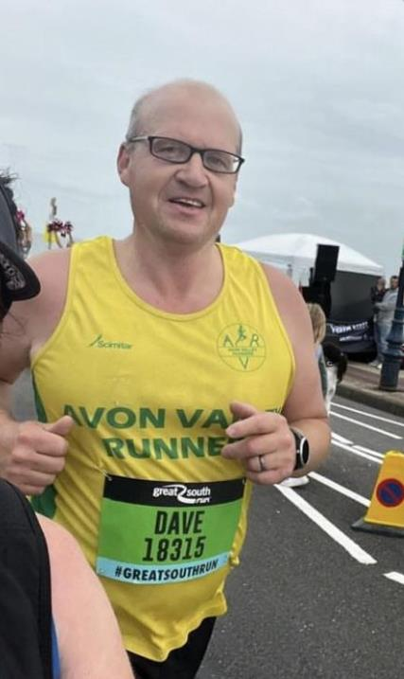
Secretaries Report
Dave Hyde

Slide 12
We have completed in the Road Race League and Off Road League with notable success.
Our tremendous events have continued be a success within the club and externally:
Westbury 5k
Over The Hills
Wiltshire Half Marathon
Stan Farr
None of this would be possible without the fantastic Race Directors who have stepped up and run the events but also you, our members, who have volunteered far and wide with tremendous feedback.

Slide 13
AVRY has continued to go from strength to strength as have the run groups and track sessions put on by our run leaders and coaches.
We had a great C25K series proving, leading to a 5K to 10k Improvers Group.
Goal Getters scheme has again been a massive success
Our Multi Sport AVT section has made massive growth and is becoming extremely popular.
Thank you to everyone for their support in 2023 and here's to 2024!

Slide 14
Membership Report
At the end of 2023 we have 364 members, which includes 25 life members (so 339 paying members).
Of the 364, 160 have applied for EA membership as well.
83 of the 364 are brand new members.
The totals in each age category are as follows:
V80 - 6
V70 - 12
V60 - 53
V50 - 86
V40 - 83
Sen - 92
Youth/Junior - 32
The gender split is 50% male, 50% female.
NB. For info the total members in 2022 was 373 including 25 life members and with 168 of those being EA members as well.

Slide 15
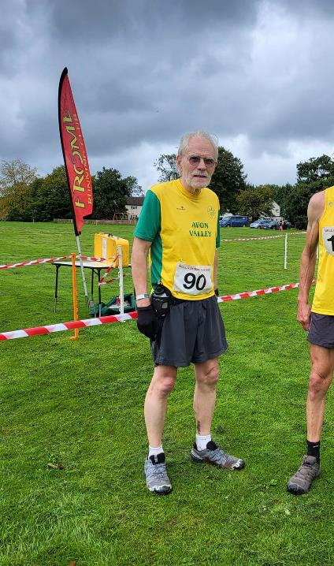
Off Road Report
Andrew Sharratt

Slide 16
For AVR 2022/23 season Veryan Cranston was a clear ladies Off Road
winner with 39 points, being 1st AVR lady in 7 out of 8 races 25 points ahead
of Fiona Newman who came 2nd and Fiona Gibbs 3rd. For the men Frank
Lamerton came 1st, Richard Newman 2nd and Gary Macalister 3rd. Out of 5
races run Gary MacAlister came 1st or 2nd AVR in 4 of them.
Mike Towler came 1st AVR all three races he ran. AVR were 4th in both team divisions
1and 2 .
3 races for the 2023/24 season have taken place, Gemma Knudsen leads as
AVR 1st lady, Isabella McNally 2nd and Fiona Gibbs 3rd. For the men, Ben
Mees is in AVR 1st placed followed by Gary Day and Daniel Colman. All to
play for!
During the 2023 season 26 ladies and 40 men took part but only 10 and 14 respectively took part in more then 1 race. For the 2024 Season, 17 ladies and
32 men have taken part so far. For Over the Hills 34 AVR runners took part,
White Horse Gallup had 30 AVR runners - fantastic. For Yarnbury Yomp 6 runners – Oh!

Slide 17
Many races struggled post Covid with registration numbers. The situation (at least
for League events) is better in 2023/24 in that some races are sold out with waiting lists and others are filling up more quickly. Other events are still adverting early
bird discounts indicating, as a minimum, nervousness.
For AVR league entrants numbers have varied from 6 to >30 people. Off Road is
very much a subset of the wider club membership with a loyal core. With the
apparent general recovery in race registration, there should be an opportunity to
widen interest in Off Road running.
League success is about entrant numbers as much as high performing runners -
although it’s great to have those at the front collecting prizes. Chippenham and
Royal Wootton Bassett are very effective in getting large teams out, and they win!
AVR is one of the larger clubs in the area.
Should be possible to grow!! The challenge for 2024.

Slide 18
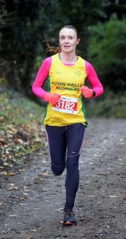
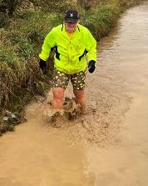
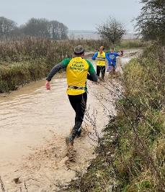
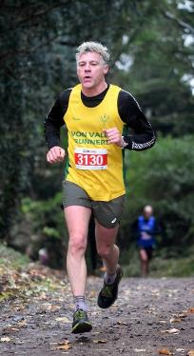
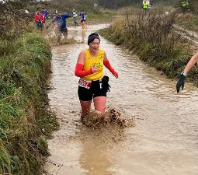
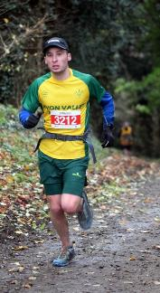
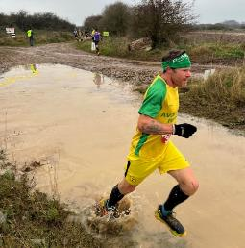
………….whish you were here……

Slide 19
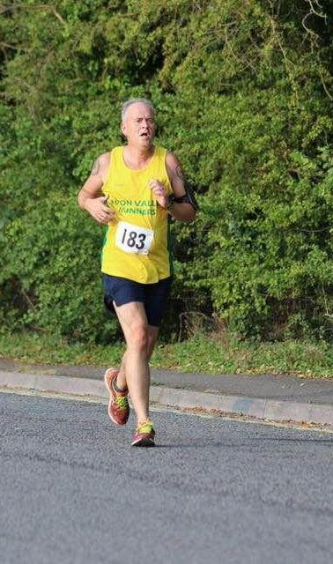
Road Report
Martin Russam

Slide 20
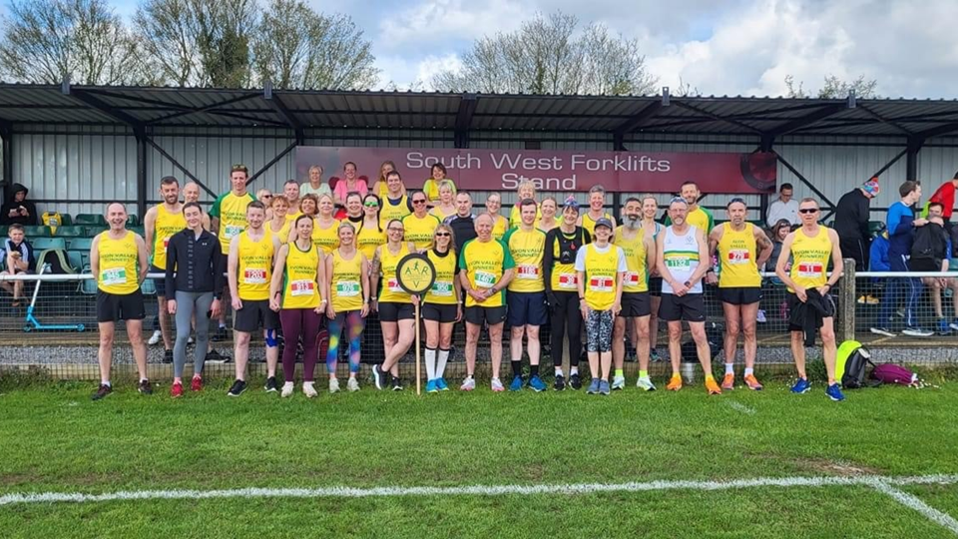
Road Report

Slide 21
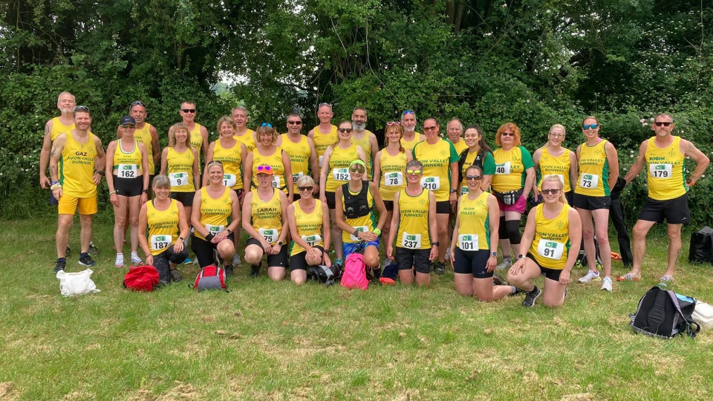

Slide 22
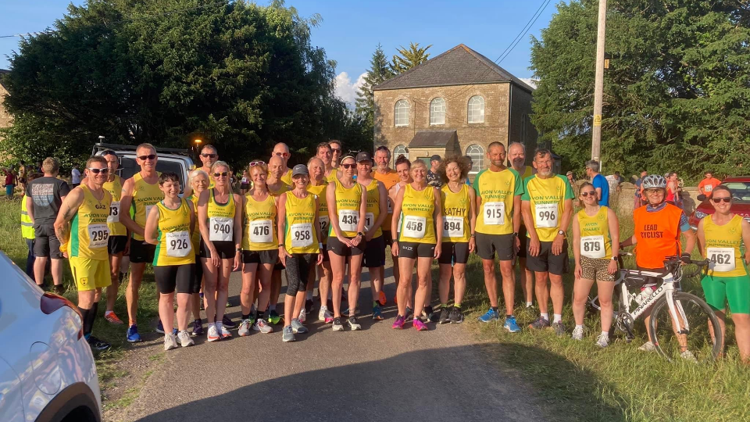

Slide 23
The 2023 Wiltshire Road Race League (WRRL) fixtures (which were the same as the AVR Road Race League) took place with the best 6 of the 8 races scoring for the club and athlete. This year's races were Devizes Half, Corsham 10k, Broad Town 5 mile, Heddington 5k Series, Great Chalfield 10k, Wiltshire 10k ‘Lightning Bolt’, Chippenham Half and Devizes 10k.
Our A team were runners up to Wootton Bassett by 3 points and our B Team finished 8th.
Fiona Price was 3rd female overall & won the FV50 category & Rosemary Barber the FV70 category. Rosemary also won the Wiltshire 5 mile championship race at Broad Town and the Wiltshire 10k for her age category. We also had Sharon Firkins Annalie Jane & Emily Dye join Fiona & Rosemary in the top 25. We had 52 female runners run at least 1 race but only two run 6 out of the 8. Fiona finished top of the AVR league with Sharon 2nd and Annalie 3rd.

Slide 24
Robin Mark-Schols won the MV60 category & the Wiltshire 10k for his age category. Ed Knudsen also won sliver at the Chippenham Half championship race. We also had Peter Veleski, Gary Day & Paul Dredge in the top 10 with Tim Burrell & Scott Green joining Robin in the top 25. We had 50 male runners run at least 1 race with eight running at least 6 out of the 8. Peter finished top of the AVR league with Gary 2nd and Paul 3rd.
Well done all & to all who ran in the road race league races.

Slide 25
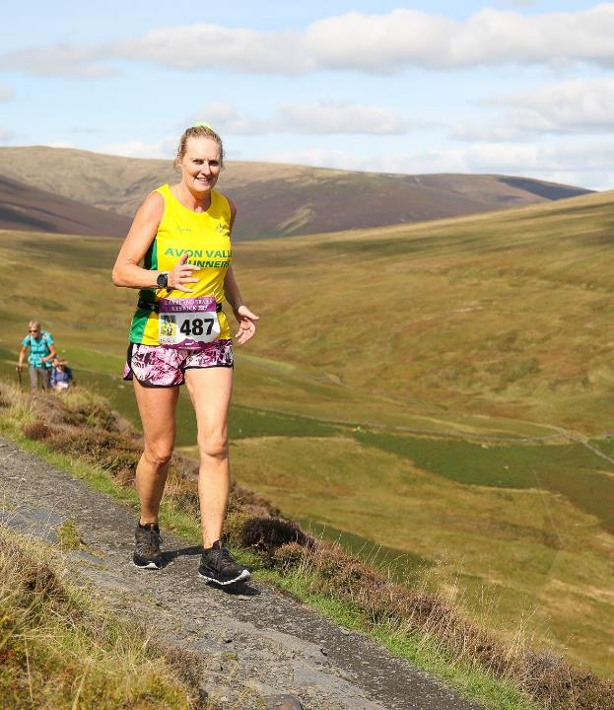
AVRY Report
Debbie Ellis

Slide 26
AVRY Report
AVR Youth was in 2 halves in 2023 with the first 6 months being headed up by Rich Ayling and
sessions being on Monday and Wednesday evening.
With some of our youth reaching ages 16 and 17 this year and the stepping down of 3
longstanding AVRY volunteers we introduced a new structure.
The second 6 months saw Chris Redshaw take over as head coach and we now only run a
session on a Wednesday evening. This is working really well and proving successful with youth
members increasing slowly.
Tim Burrell has been volunteering regularly along with Tina Towler and Tim has now qualified
as a full CIRF which is a great asset to the Youth volunteer team.
The young athletes have had some great races over 2023 and have achieved some good results
Ed Hill for U13 Boys was selected to represent the County at South West Champs on 8th
January.
George Sawyer - Completed the Street 5K series and improving his time each race to a PB of
21.29 and was Junior Runner for the last race and for the overall series.
Ed Hill – Calne 1.5K – 1st in his age group
Josh Dines – 3K Bristol Track Club run
Peter Yoemans – 3K Bristol Track Run
Imogen Smart – 2K Clock Change Challenge – 4th girl Finisher
Tony Orr – Age related European Biathlon Qualifier race – 6th place and reserve qualifier
Will Smith - Age related European Biathlon Qualifier race – 1st place and qualified
Will Smith - Torbay Triathlon – 1st Place

Slide 27
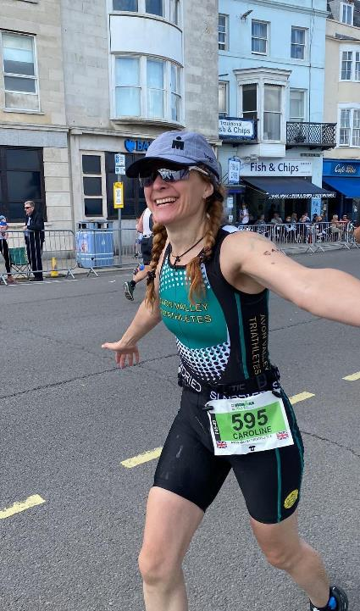
AVT Report
Caroline Scott

Slide 28
AVT News In Brief
- Working group roles established further
AVT league published online
AVT handbook finished and published
- Developed the AVT Pathways Messenger group
- 5 day a week swim offering now available (with financial benefit to both
Chillies and AVT - called the swim collaboration)
- Set up associated AVT swim messenger group
- Athletes competing at European and World Champs in 2023 all of which
placed in top 10 at either World or Europeans.
- Additional GB qualifiers e.g. Emily Dye, Jen Nattrass, Steve Clark, Sally Frawley
- Introduction of the AVT calendar available online
- Many from the AVT section completed Olympic distance or longer in
triathlon e.g. Long Course Weekend, Mumbles Centurion, people new to
Ironman entering both full and halves
Run to breakfast offered a great platform for AVT social, goal getters and
running at different distances

Slide 29
- Cycle to coffee began and still in its infancy
- A partnership with Westbury Wheelers cycling club was formed and make
use of the services that could offer is still in its infancy
Introduction of the AVT run vests
- Transition support session
AVT - Looking into 2024
- More AVT focus events including: Oldbury, Vobster Aquathlon, Windsor,
Chilly, AVT TT, (including more timed events) - champions for events
published upfront
51fiver - 10 relay teams will be entered again and runners and triathletes
will all be encouraged to get involve
- More focus on supporting others at their A race
- Run to Breakfast going monthly (alongside cycle to breakfast)
- try an aquathlon and try a tri to be held early in the year again to bring in
beginners and kickstart the fun
- More GB qualified athletes and other going for GB qualification

Slide 30
- Support for some Ironman events with quite a few AVT entries into full and halves
- More integrations with the run section through semi-joint calendar of events
- More support for isolated bike and swim events e.g. Serpentine or Ride
London or segment of the month
- AVT news to be streamlined a little further
- More promotion of AVT to the wider community
- Working on a template of weekly training on offer from swim to bike to
brick
- Cycle coaching offers from Westbury Wheelers to AVT
- Nutrition workshop

Slide 31
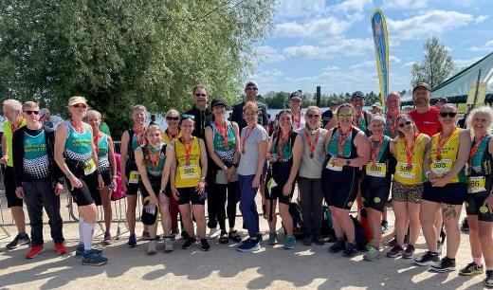
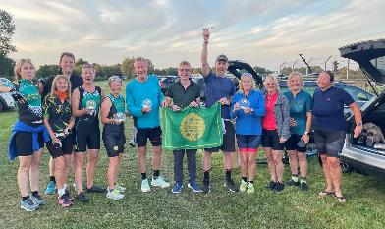
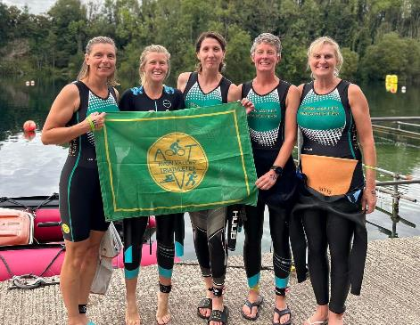
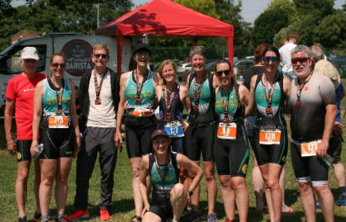

Slide 32

AVR Goal Getters
This year we had 32 members who achieved a GG medal which is excellent.​
We have to give a special mention to Jayne Williams, Ceri-Anne Case, Stuart Mackie, Paula Phoenix and Tracey Webb who achieved double Gold in ​
Me vs Me​
GG Challenge​
Thank you very much to the organisers and mentees​
Sean Price – Presentation
Notes:
SP

Slide 33
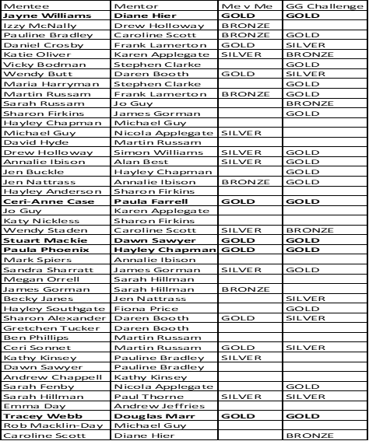

Slide 34
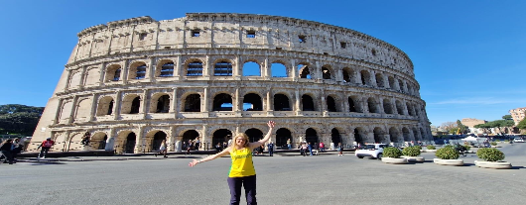
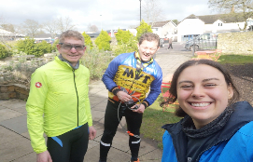
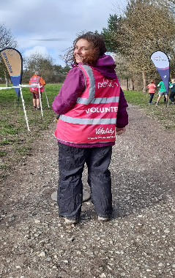
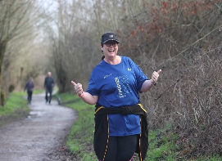
March
March saw some Goal Getters off to a quick start & achieve points for…
AVR/AVT kit at a landmark
Parkrun
Cycle To Breakfast
Contributing to the AVR Newsletter
Volunteering Parkrun
Run to Breakfast
Multisport Event

Slide 35
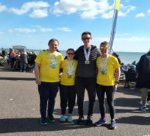
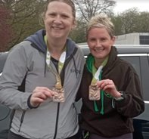
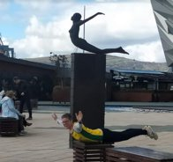
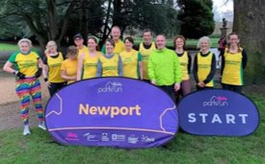
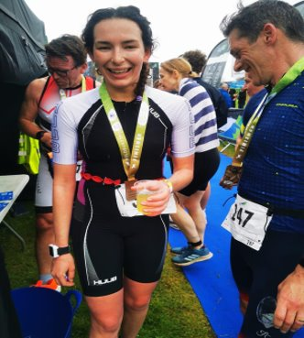
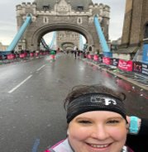
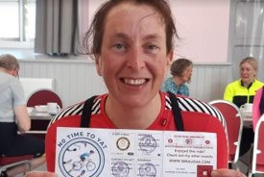
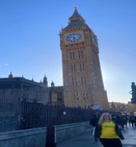
April​
​
Following the launch meeting, we have had great representation across races, events and activities. ​
​
In April Goal Getters achieved points for…​
​
The AVR Newport parkrun trip​
Brighton Marathon​
London Marathon​
Corsham 10km​
Parkrun tourism​
Multi-sport events​
Run to Breakfast​
AVR/AVT kit at a landmark​
Kew Gardens Half Marathon​
Devizes Half Marathon

Slide 36
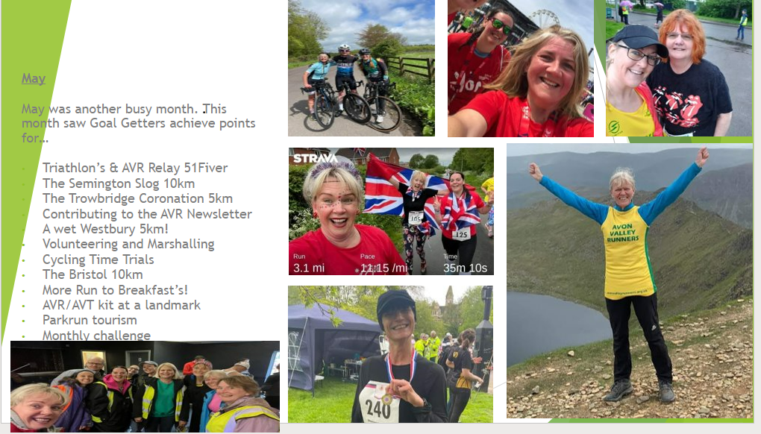

Slide 37
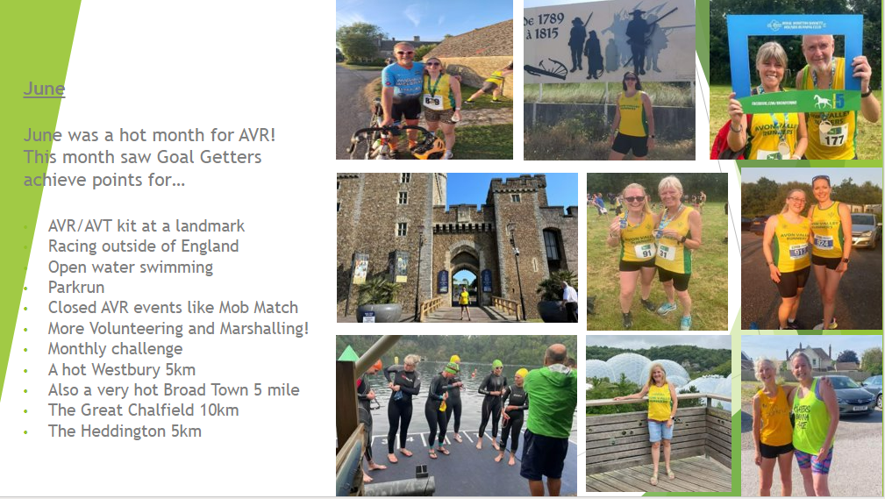

Slide 38
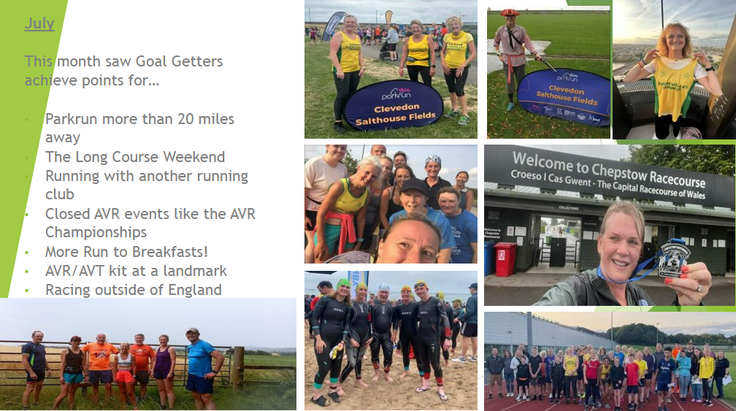

Slide 39
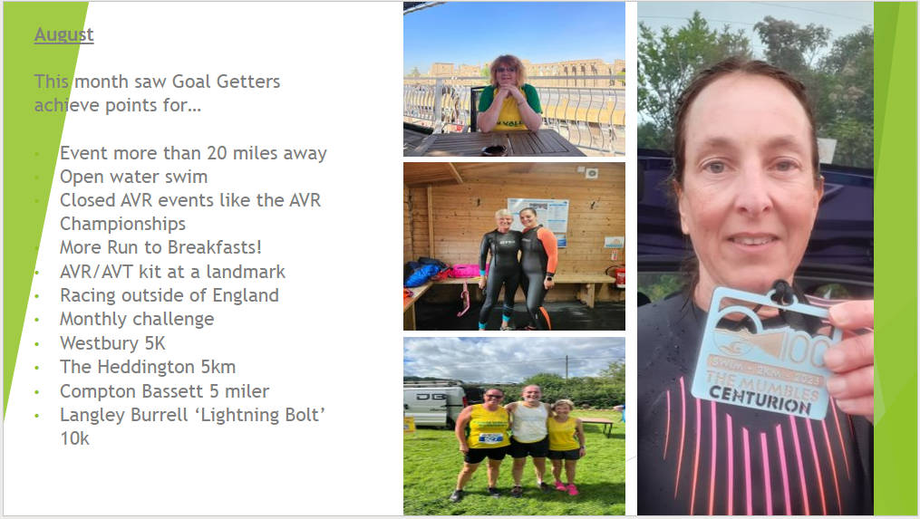

Slide 40
Club Development Survey
The AVR Club Development survey was created to gain more insight into the needs, wants and wishes for our club members, this will also help the club with future planning and developing a vision and strategy
The survey was sent to all club members by email and links were also shared across social media
The committee were presented with the survey overview and key areas of the club have also been provided with more specific feedback
15% of the club provided feedback, this sits within the typically expected figures for a survey of this type

Slide 41
Club Development Survey highlights
67% of people know who is on the committee and the club roles
78% of people felt that the current coaching offer is appropriate and is meeting their needs, you also shared ideas on how to improve this further
You told us your preferred events
You asked for a new members booklet and for club members to be better informed
You want us to keep running at the heart of the club
You asked the committee to listen to you
You asked the committee 12 key questions
You shared what you love about AVR
You thanked the coaches, leaders, volunteers and committee for all they do

Slide 42
Implementation and what‘s next
The committee will be gathering more regular club members feedback at club sessions and online
A new members handbook is being created
We already have 2 new LiRF’s from the survey responses
Our notice boards will be updated in January
The committee and their roles will be spotlighted throughout the coming months
The coaching team are working together to review feedback and will make appropriate adjustments to improve the offer
The answers to the committee questions are available tonight and will be shared with all club members

Slide 43


Slide 44
Constitutional
Amendments
None to declare
Notes:
WW

Slide 45
Membership Fees
The committee proposes that we keep the annual membership fees for 2024/25:-
Junior/Student - £13.50
Adult - £27
EA membership will remain optional for those people who require or wish to sign up for it but this has gone up by £2 this year to £19. Therefore adult membership with EA added on will be £46.
Notes:
WW

Slide 46
Lifetime Membership

Slide 47
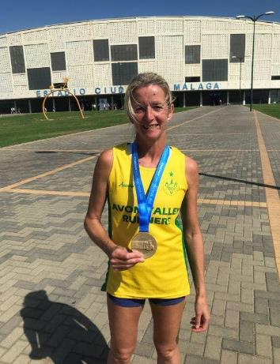
Fiona Price
Fiona has shown continual commitment to AVR both as coach and an athlete
She coaches an interval session every Wednesday alongside Sean and also gives 1-2-1 coaching support to a considerable number of athletes.
She is also a highly accomplished athlete in hr own right regularly flying the flag for AVR.
Fiona can always be relied upon to wear the AVR colours with pride.
Thank you, Fiona, for your continued commitment and support Avon Valley Runners.

Slide 48
Next Year
Conclusion
Next year will see the club focus on several areas, focusing on what has been highlighted through the Development Survey
Notes:
VB

Slide 49
Election of Committee
Name | Role
Sara Robert | Chair
Dave Hyde | Honorary Secretary
Katie Oliver | Assistant Secretary
Vicky Bodman | Vice Chair
Simon Reeves | Honorary Treasurer
Debbie Ellis | AVRY Secretary
Martin Russam | Road Race Secretary
Andrew Sharratt | Off Road Race Secretary
Emma Day | Membership Secretary (Admin)
Caroline Scott | Multi Sport Secretary
Sandra Sharratt | Safeguarding Lead
Hayley Anderson | Minutes Secretary
Jay Sims- Bagshaw | Committee Member
Julian Roughley | Committee Member

Slide 50
Welfare Officers
Name | Role
Jay Sims - Bagshaw | Welfare Officer AVRY Female
Alan Button | Welfare Officer AVR Male

Slide 51

Notes:
WW

